Slide 1
State Network Density by IGO Membership

Slide 2
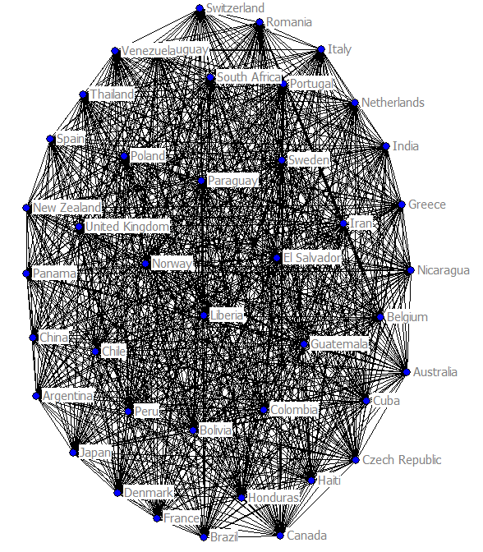
Matrix 3
State network density by IGO membership
1919

Slide 3
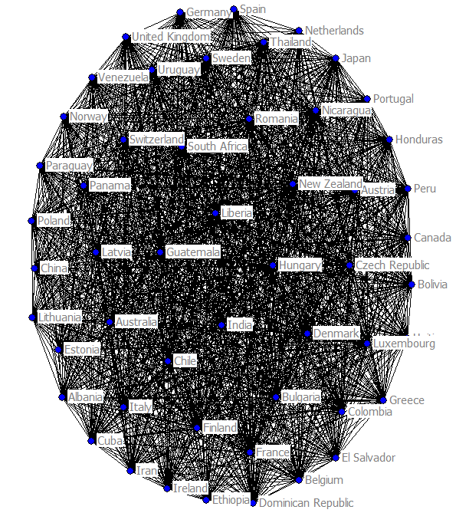
Matrix 3
State network density by IGO membership
1930

Slide 4
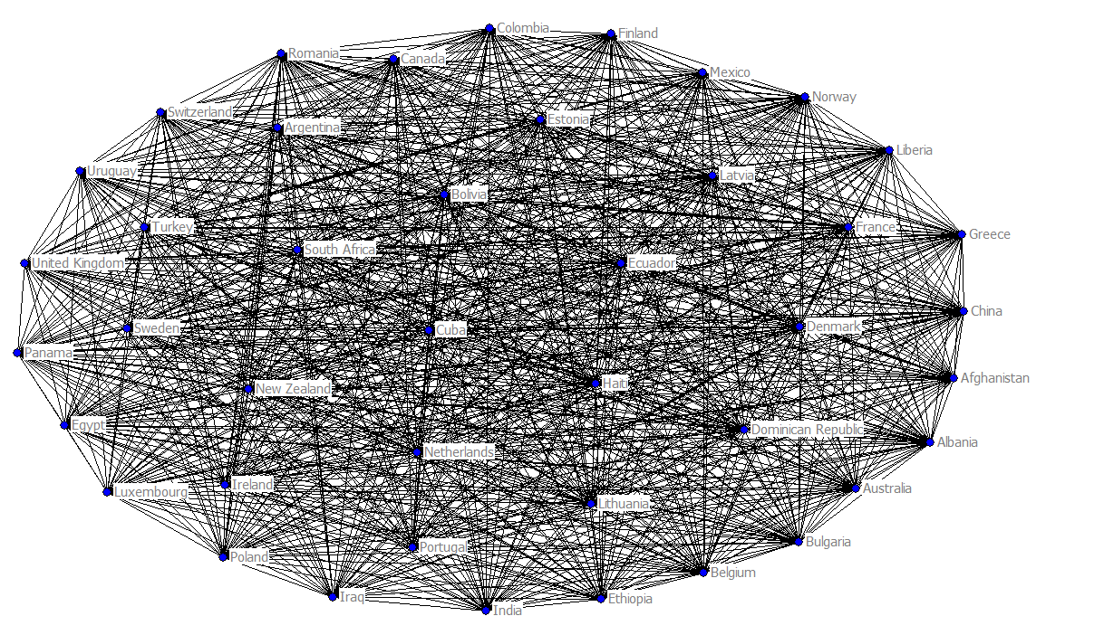
Matrix 3
State network density by IGO membership
1940

Slide 5
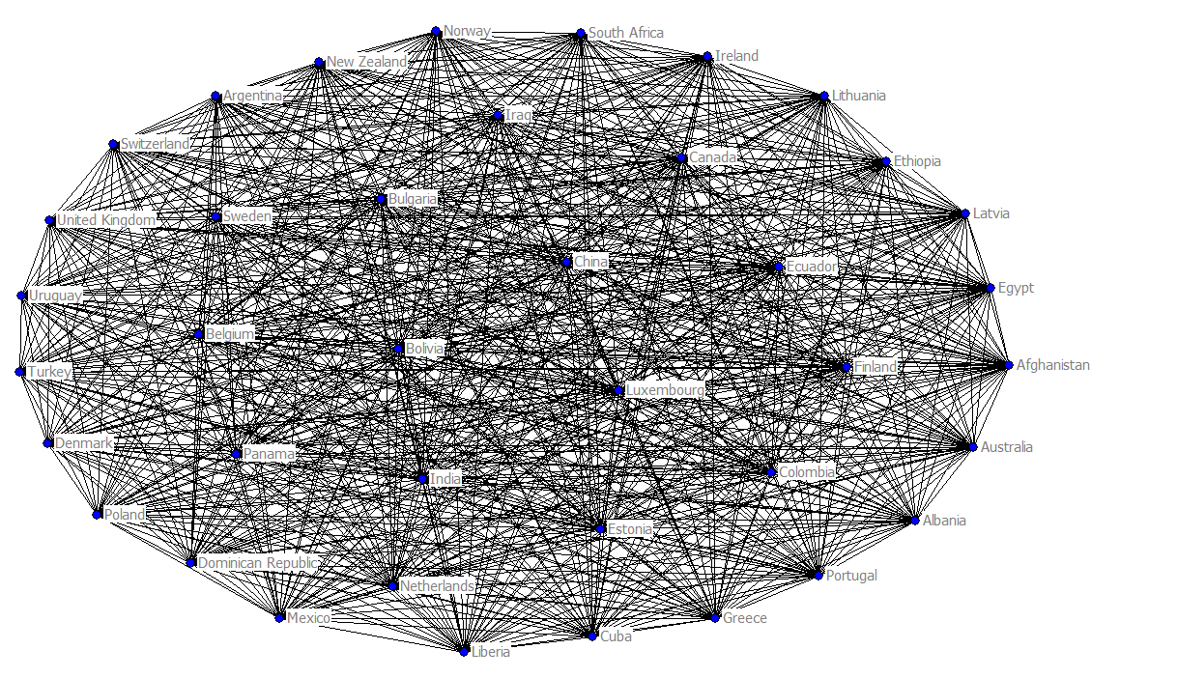
Matrix 3
State network density by IGO membership
1944

Slide 6
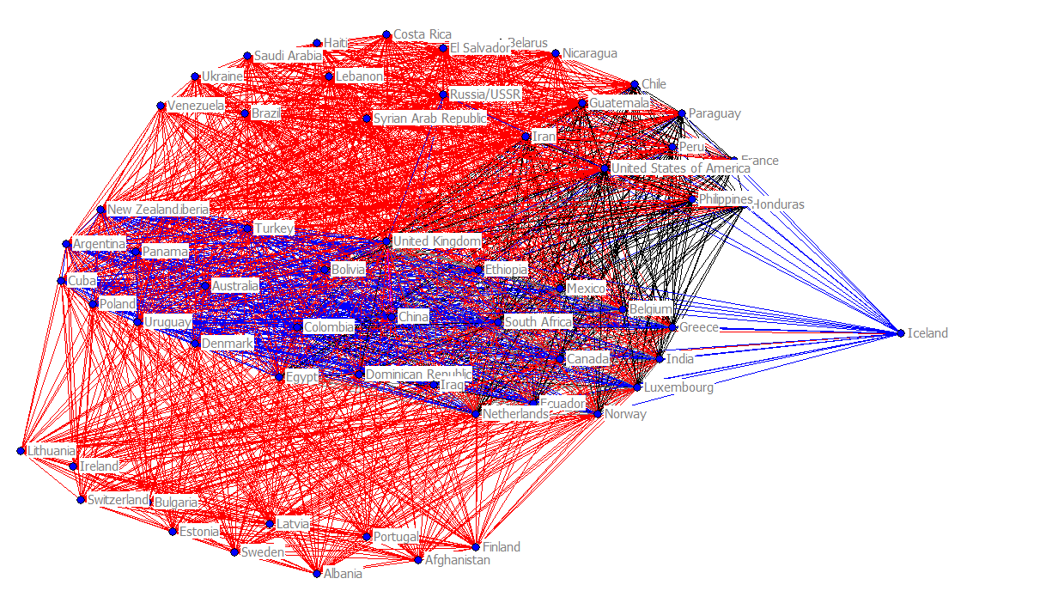
Matrix 3
State network density by IGO membership
1945

Slide 7
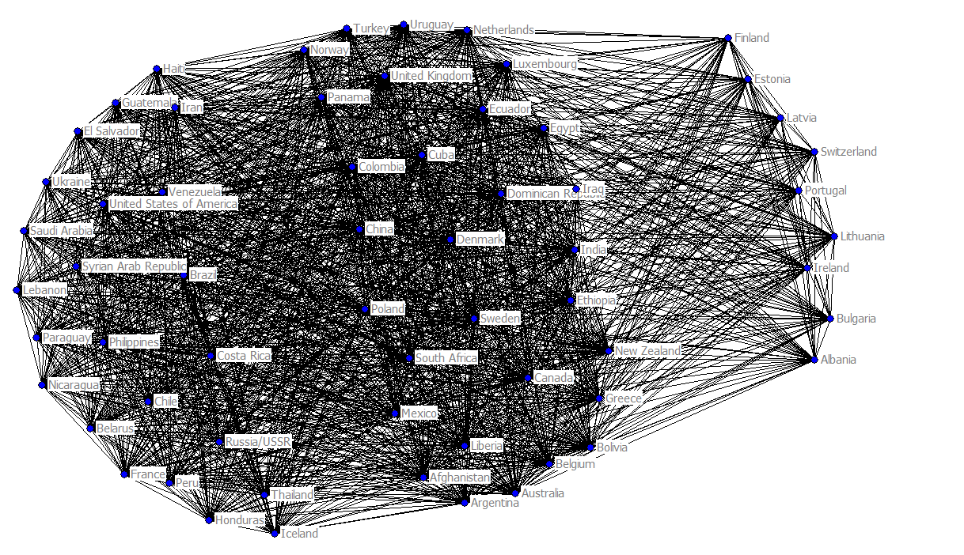
Matrix 3
State network density by IGO membership
1946

Slide 8
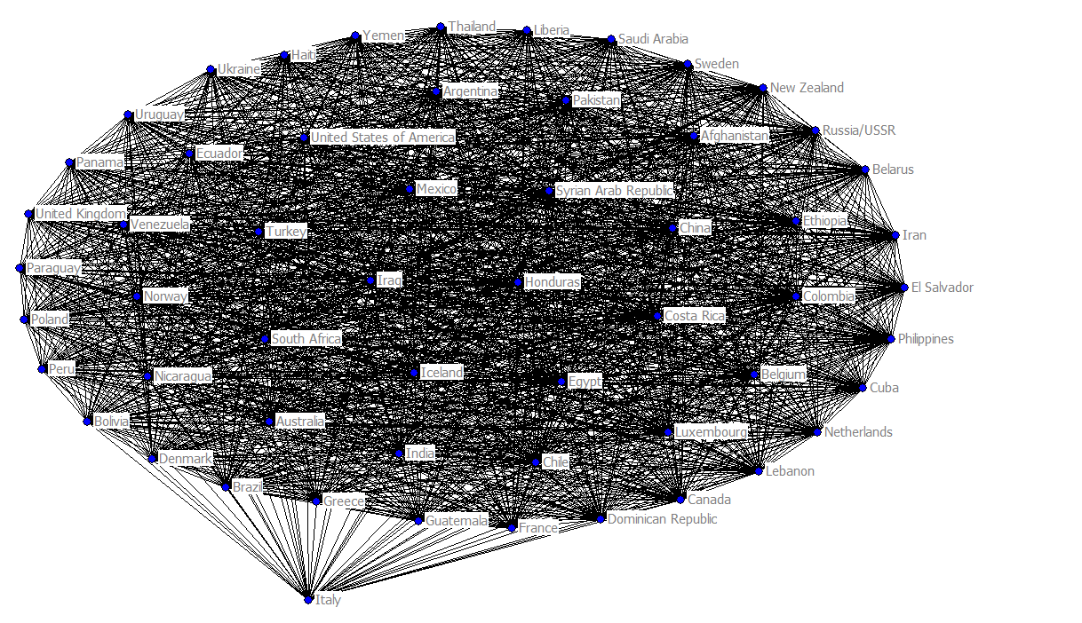
Matrix 3
State network density by IGO membership
1947

Slide 9
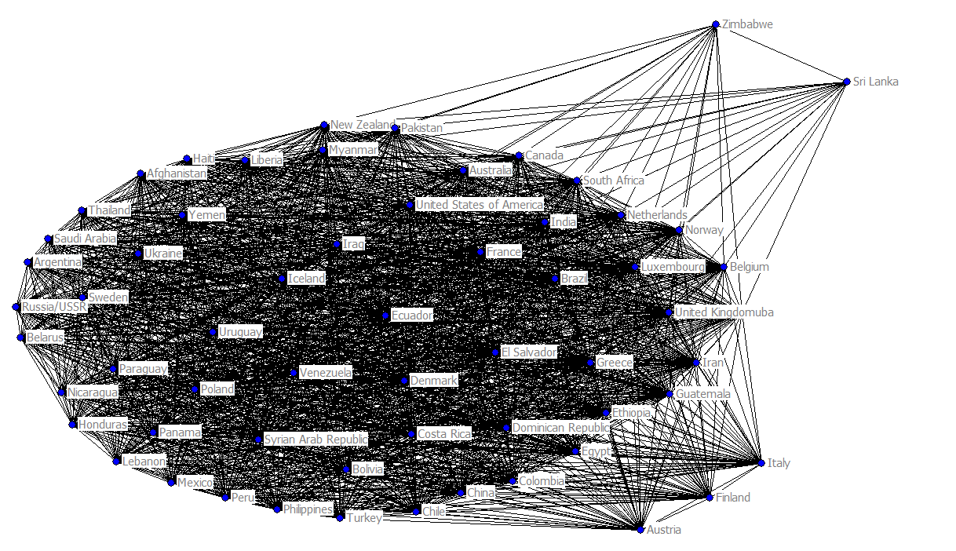
Matrix 3
State network density by IGO membership
1948

Slide 10
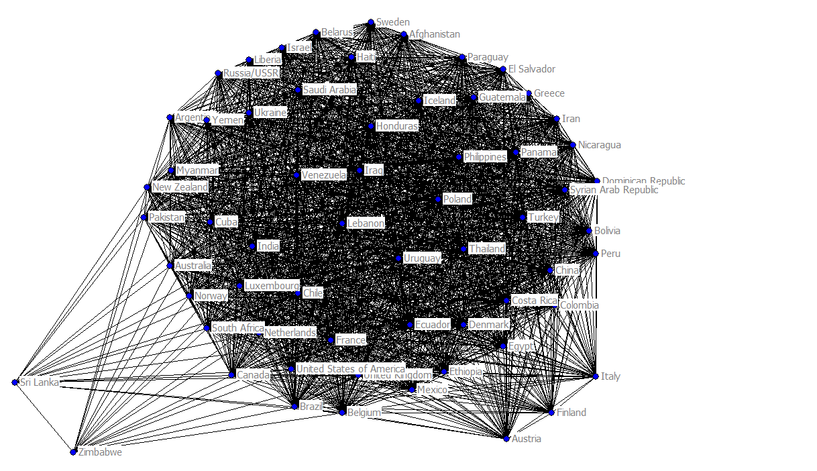
Matrix 3
State network density by IGO membership
1949

Slide 11
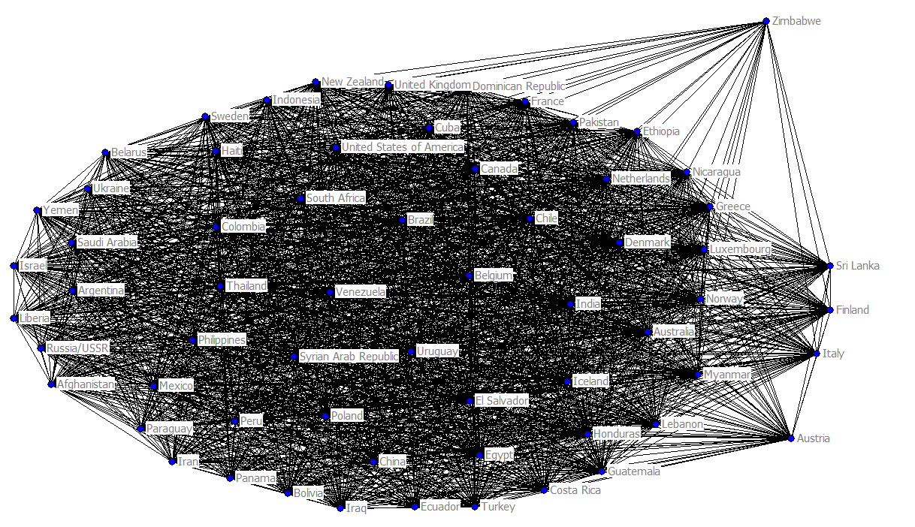
Matrix 3
State network density by IGO membership
1950

Slide 12
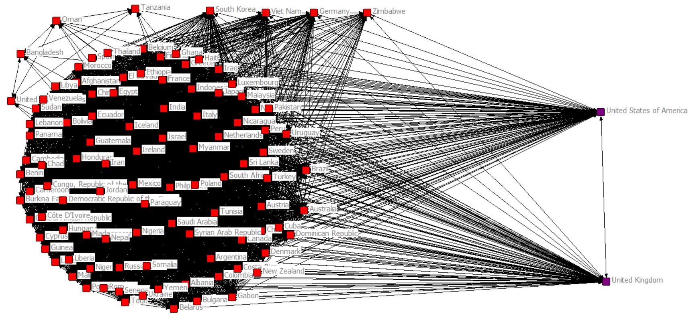
Matrix 3
State network density by IGO membership
1960

Slide 13
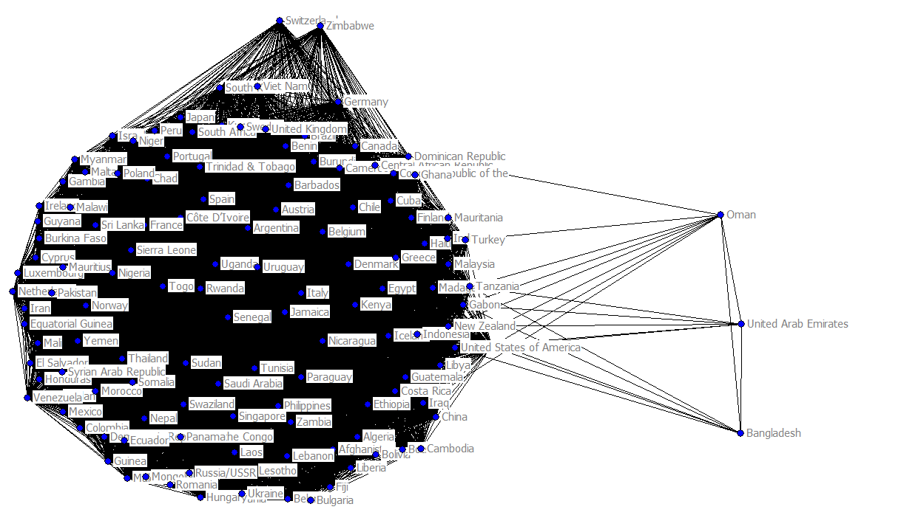
Matrix 3
State network density by IGO membership
1970

Slide 14
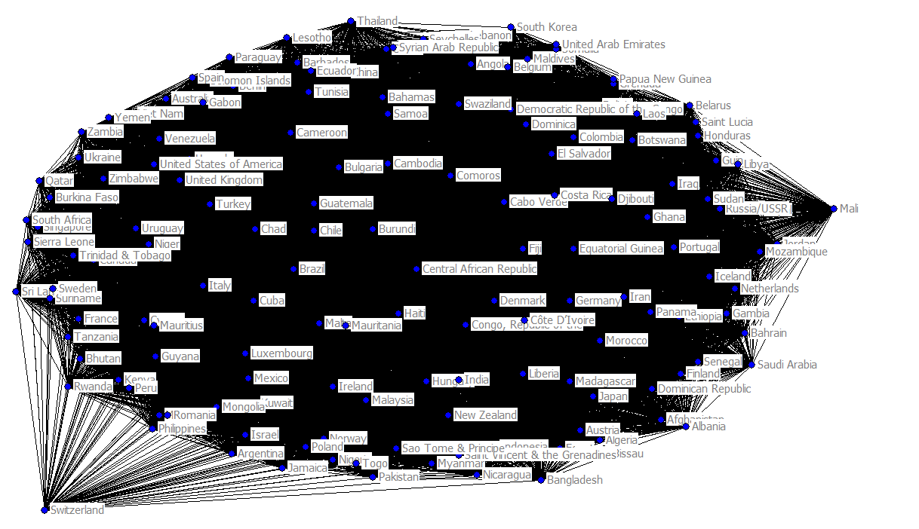
Matrix 3
State network density by IGO membership
1980

Slide 15
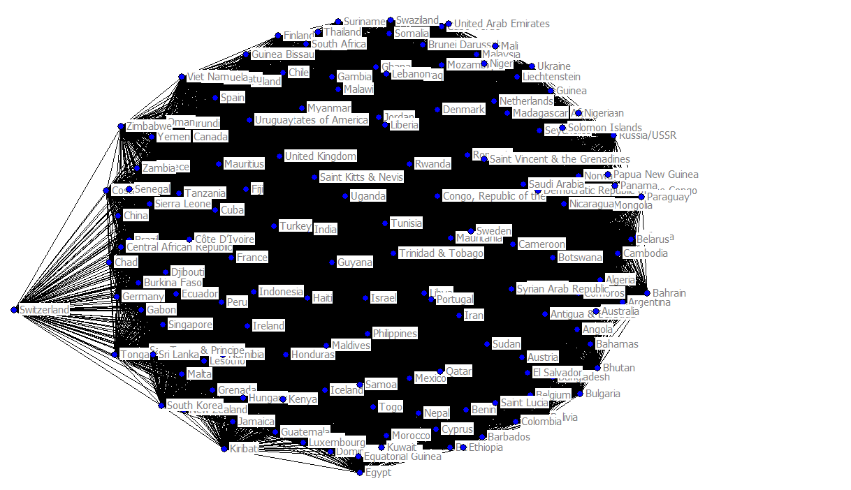
Matrix 3
State network density by IGO membership
1990

Slide 16
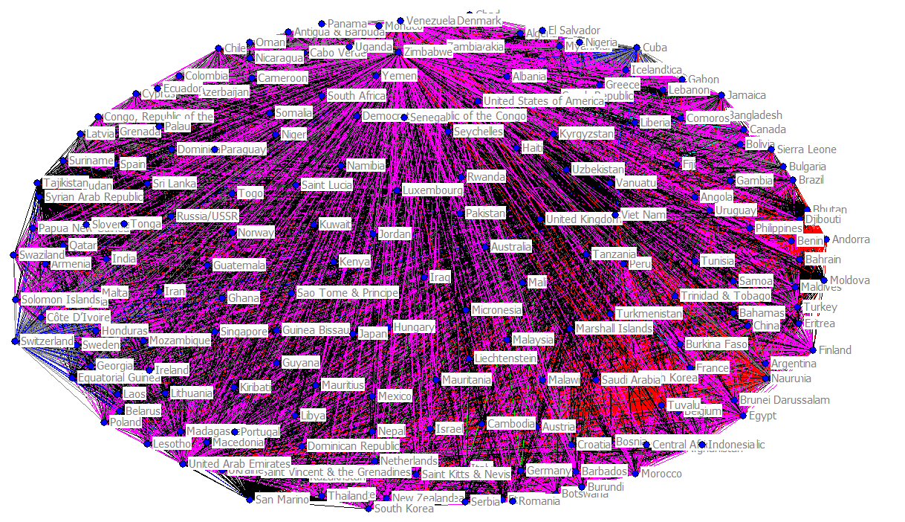
Matrix 3
State network density by IGO membership
2000

Slide 17
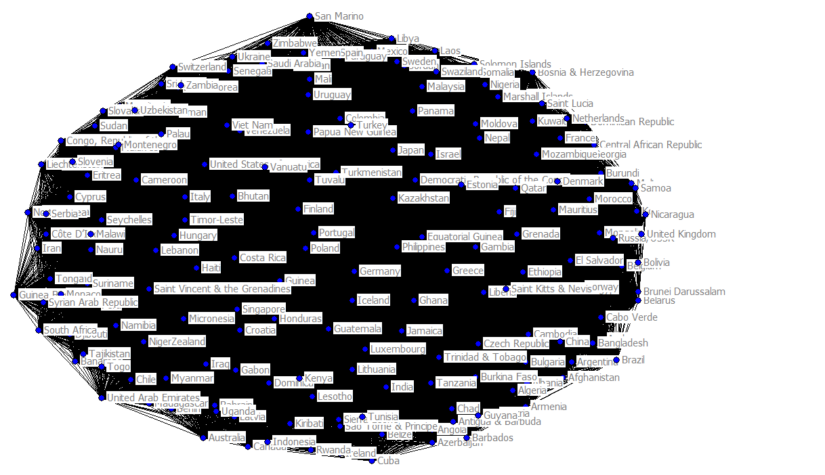
Matrix 3
State network density by IGO membership
2010

